Slide 1
Rockets
Mrs. Malcom

Slide 3
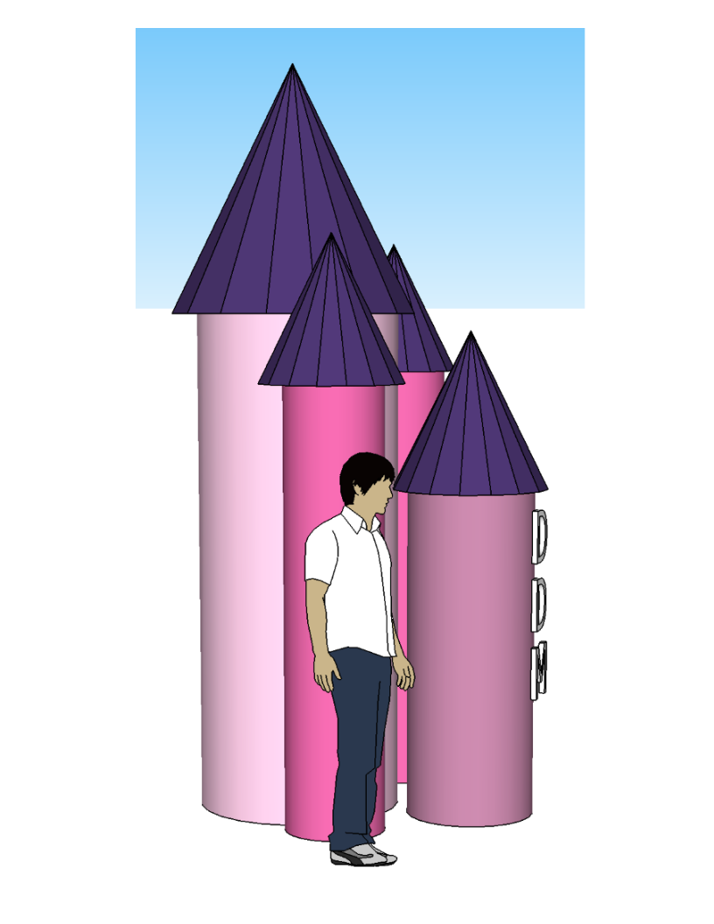

Slide 4
