Slide 1
Dimensional House
By: Darcie Malcom

Slide 3
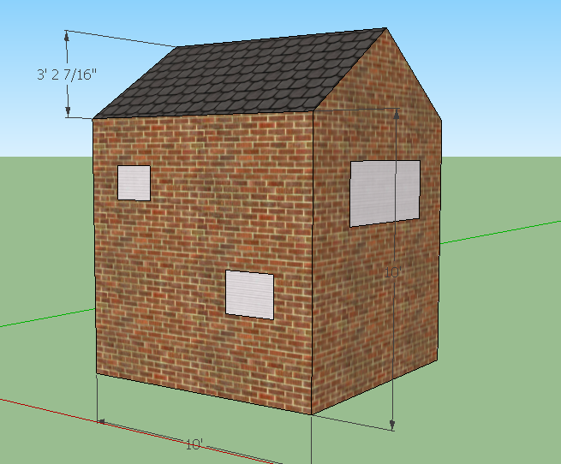
Screen clipping taken: 4/26/2010, 12:45 PM

Slide 4
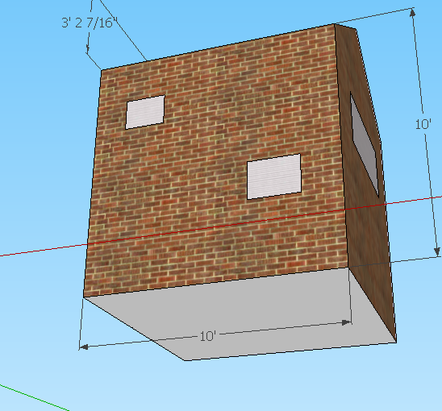

Slide 5
